Slide 1

Advances in Deep Learning with Applications in Text and Image Processing
- Transformer Architectures -

Slide 2
Why Do We Need Transformers?
Method / Model | Type | How It Works | Captures Order? | Captures Context? | Limitations
Bag of Words (BoW) | Feature representation | Counts word occurrences in a document | ❌ No | ❌ No | Ignores order and context; sparse vectors
TF-IDF | Feature representation | Weighted BoW by inverse document frequency | ❌ No | ❌ No | Still ignores order/context; sparse; high dimensional
Word Embeddings (Word2Vec, GloVe) | Dense vector representation | Learns word vectors from co-occurrence | ❌ No | Partial (fixed embedding) | Cannot handle polysemy (same word different meaning in context)
One-Hot Encoding | Feature representation | 1-hot vector per word | ❌ No | ❌ No | Very sparse; no semantic meaning; ignores order
ANN (Feedforward NN) | Neural network | Input → hidden layers → output | ❌ No (unless explicitly designed) | ❌ No | Cannot capture sequences; poor for text directly
RNN | Sequential neural network | Processes tokens step by step | ✅ Yes (sequential) | Partial | Slow (sequential); vanishing gradients for long sequences
LSTM | Sequential neural network | RNN with memory gates | ✅ Yes | ✅ Long-term | Slower than feedforward; still sequential; harder to parallelize
GRU | Sequential neural network | Simplified LSTM | ✅ Yes | ✅ Long-term | Still sequential; slower training than transformers
Transformer | Neural network | Self-attention across all tokens | ✅ Positional encoding | ✅ Full context | Requires more memory for long sequences; can be heavy; attention computation ~O(n²)

Slide 3
Key Takeaways (Transformer vs Others)
Order:
BoW, TF-IDF, word embeddings → ❌ ignore order
RNN/LSTM/GRU → ✅ sequential order preserved
Transformer → ✅ order encoded via positional encoding
Context:
BoW, TF-IDF, one-hot → ❌ none
Word embeddings → ❌ fixed context
RNN → ✅ partial, decays for long sequences
LSTM/GRU → ✅ better long-term context
Transformer → ✅ full context via self-attention
Speed / Scalability:
RNN/LSTM/GRU → ❌ sequential, slow on long sequences
Transformer → ✅ parallelizable, faster on GPUs
Limitation Summary:
Traditional representations → sparse, ignore semantics
RNN variants → sequential, slow, memory issues
Transformer → heavy computation on long sequences, but solves order/context/parallelism issues

Slide 4

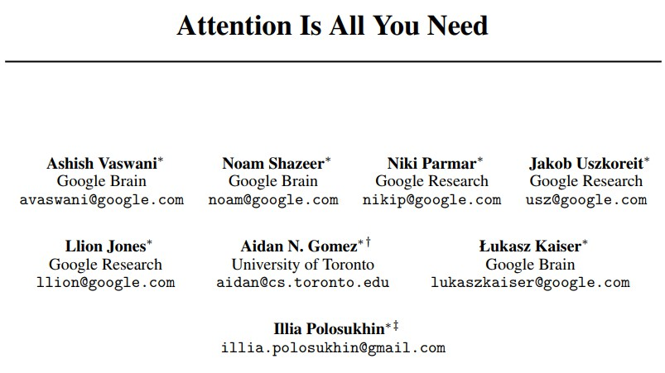
Attention is all you need!
NIPS 2017

Slide 5
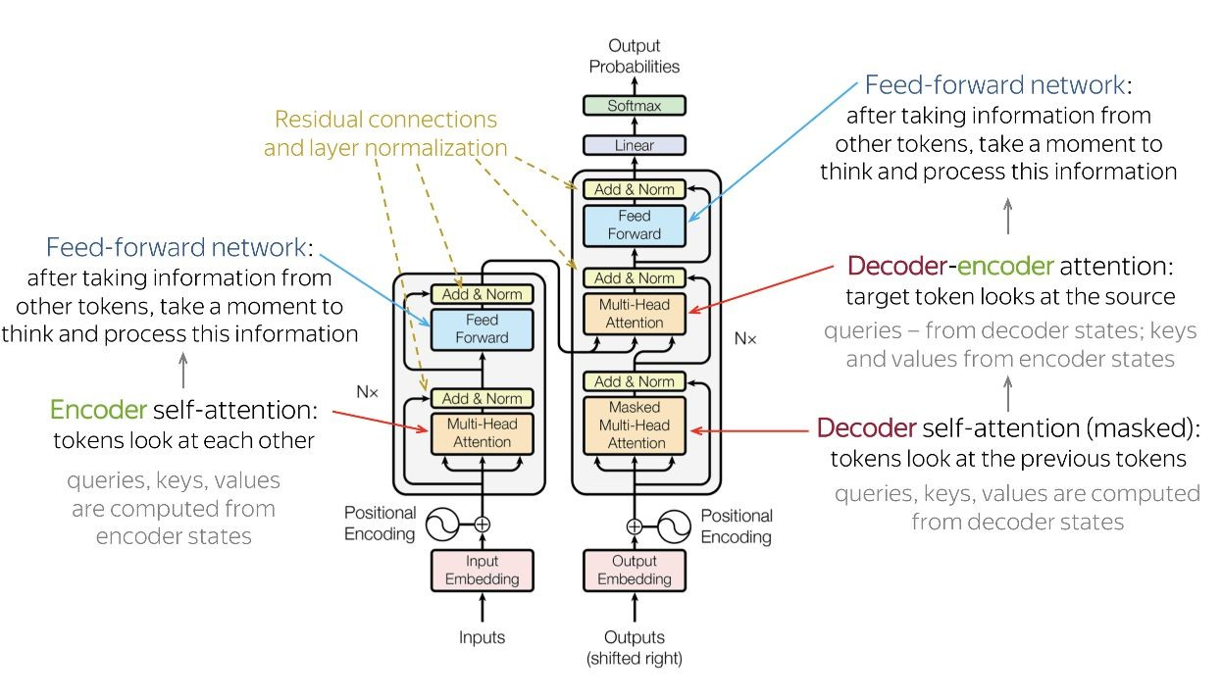
Transformer Architecture

Slide 6
High-Level Architecture
High-Level Architecture
A Transformer consists of:
1. Encoder Stack
Processes input sentence
2. Decoder Stack
Generates output sentence
Used mainly in machine translation
Parallel Processing (Transformer)
sentence:“The cat sat on the mat.”
Transformer uses self-attention:
All words: [The, cat, sat, on, the, mat]
Each word can look at all other words at the same time to compute relationships
Computations for all words can be done simultaneously on a GPU

Slide 7
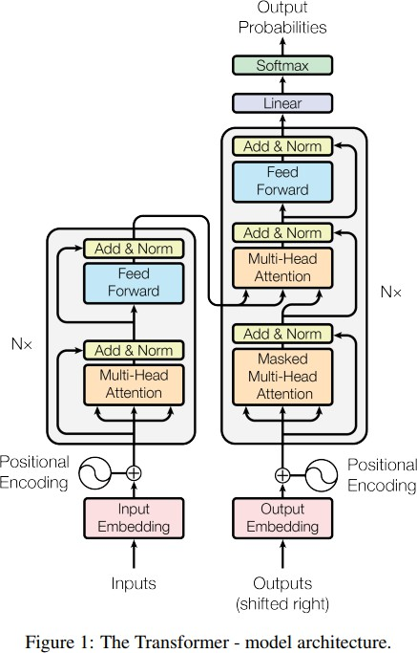
Transformer
Scaled Dot-Product Attention
Multi-Head Attention
Position-wise Feed-Forward Networks
Embeddings and Softmax
Positional Encoding

Slide 8
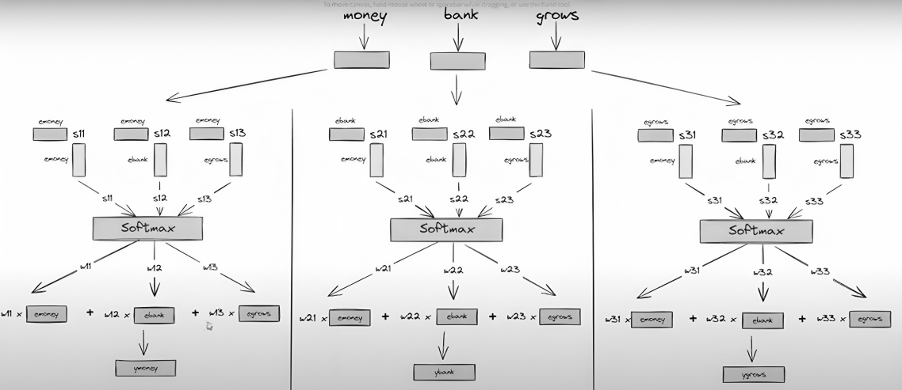

Transformer
Self Attention:
Word Usage in Context:
The examples show two different contexts:
"money bank grows"
"river bank flows"
$$s_{21}=e_{\text{bank}}e_{\text{money}}^{T}$$
$$s_{22}=e_{\text{bank}}e_{\text{bank}}^{T}$$
$$s_{23}=e_{\text{bank}}e_{\text{grows}}^{T}$$
$$e_{\text{bank}}^{\left(\text{new}\right)}=s_{21}⋅e_{\text{money}}+s_{22}⋅e_{\text{bank}}+s_{23}⋅e_{\text{grows}}$$

Slide 9
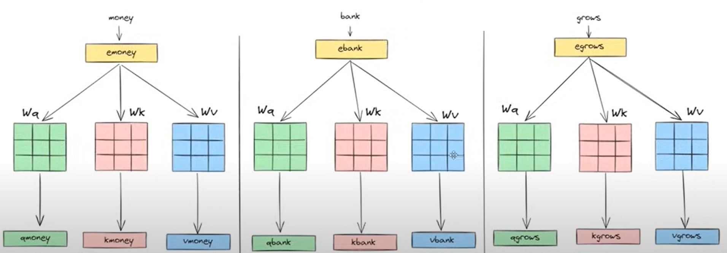
Transformer
Self Attention
Components: Query (Q), Key (K), Value (V) matrices derived from the input embeddings.
Attention Function: Scaled Dot-Product Attention.
For the self-attention mechanism, we need three sets of weights for queries (Q), keys (K), and values (V).

Slide 10
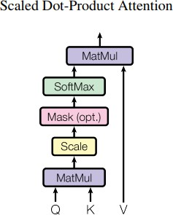









Transformer
Scaled Dot-Product Attention
Q: queries, K: keys, V: values

Slide 11
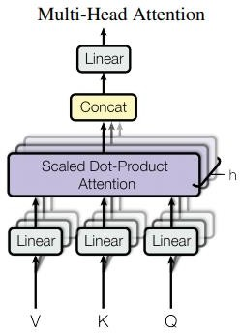

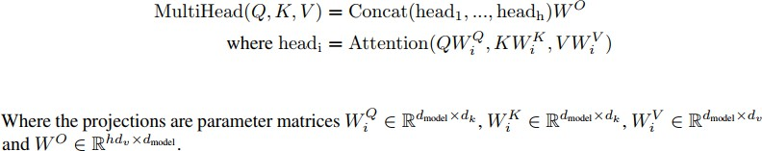
Transformer
Multi-Head Attention
The total computational cost is similar to that of single-head attention with full dimensionality.

Slide 12
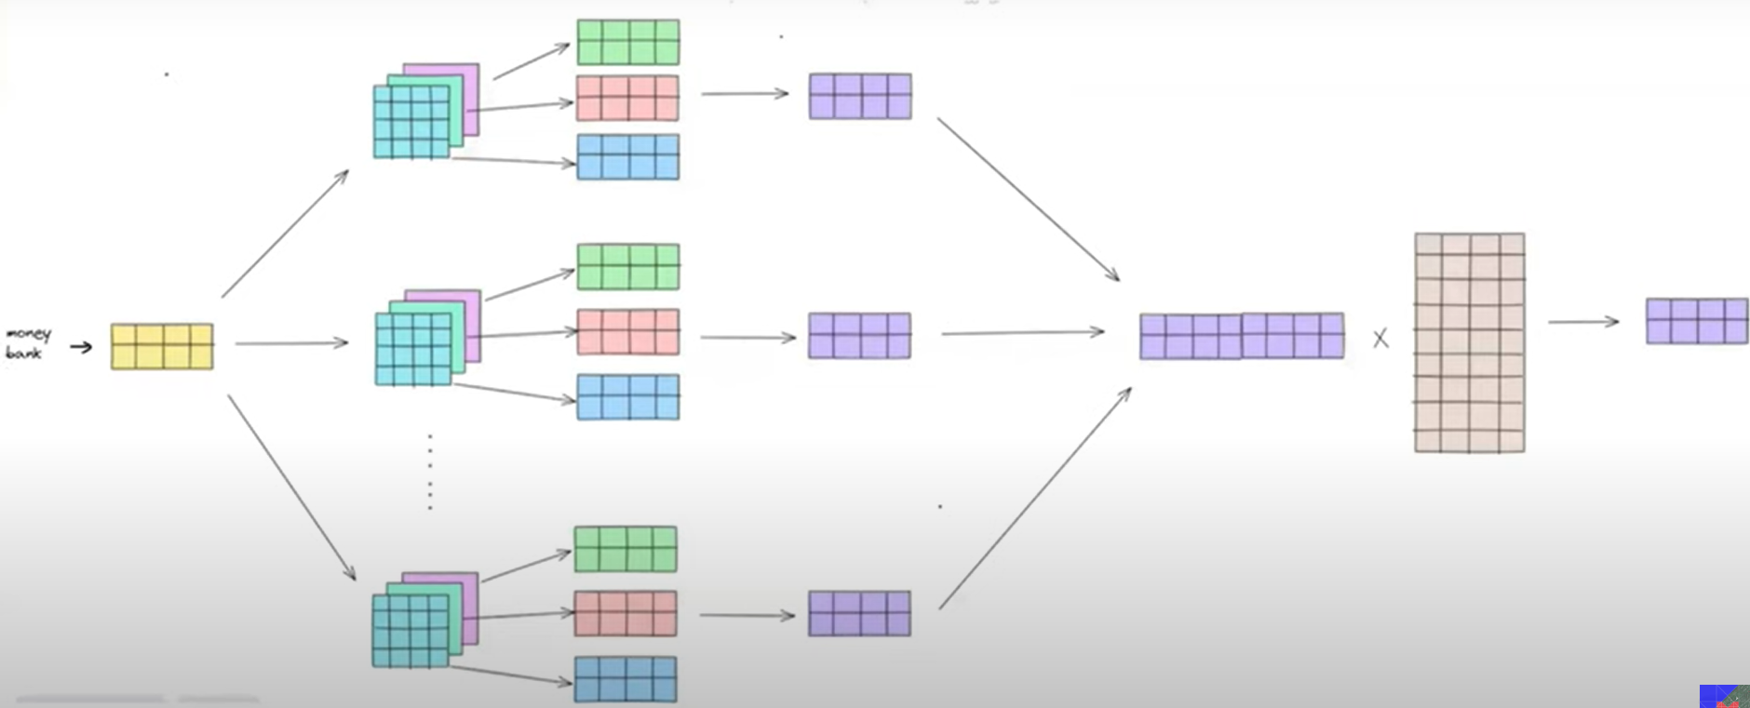
Transformer
Multi-Head Attention
Multi-Head Attention
Instead of one attention:
Use multiple attention heads
Each head learns different relationships
Example:
Head 1: Grammar
Head 2: Semantics
Head 3: Position

Slide 13
Transformer
Position-wise Feed-Forward Networks

Slide 14
Transformer
Embeddings and Softmax
Share embedding weights and the pre-softmax linear transformation (refer to arXiv:1608.05859)

Slide 15

Transformer
Positional Encoding
Reason: no RNN to model the sequence position
Two types:
learned positional embeddings (arXiv:1705.03122v2)
Sinusoid:

Slide 16
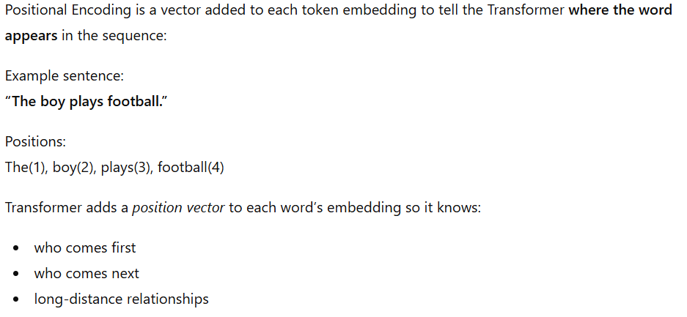
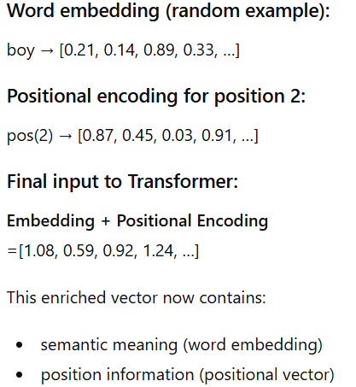
Transformer

Slide 17
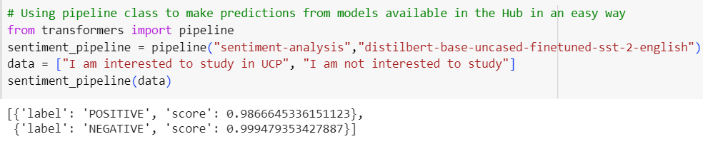
Example of Hugging Face Transformers
Sentiment Analysis

Slide 18

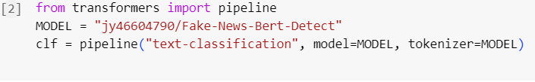
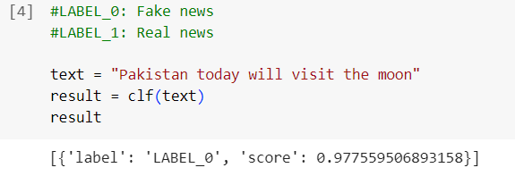
Example of Hugging Face Transformers
Fake News Detection Analysis

Slide 19

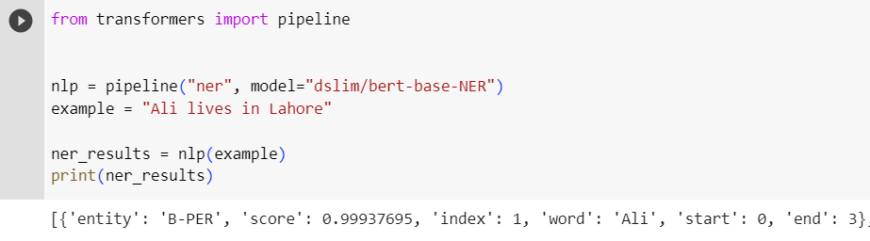
Example of Hugging Face Transformers
Named Entity Recognition Analysis

Slide 20
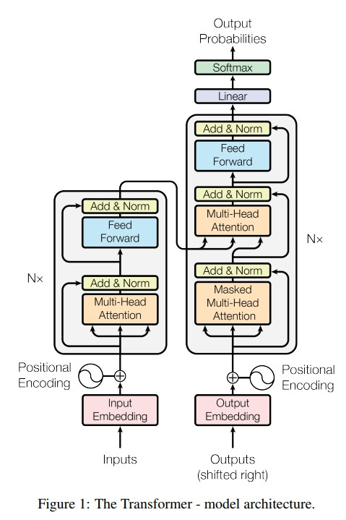
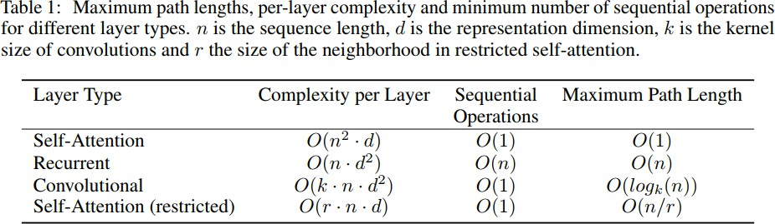
Transformer (Self Attention)
Observation:
Self-Attention has O(1) maximum path length (capture long range dependency easily)
When n<d, Self-Attention has lower complexity per layer

Slide 21
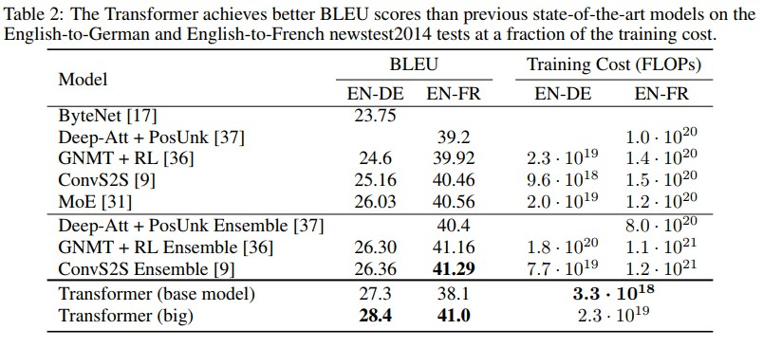
Transformer Performance
Eng-to-De: new state-of-the-art (increase over 2 BLEU)
Eng-to-Fr: new single-model state-of-the-art (BLEU of 41.0)
Less training cost

Slide 22
Transformer Performance
Some results:
source: Aber ich habe es nicht hingekriegt
expected: But I didn't handle it
got: But I didn't <UNK> it
source: Wir könnten zum Mars fliegen wenn wir wollen
expected: We could go to Mars if we want
got: We could fly to Mars when we want
source: Dies ist nicht meine Meinung Das sind Fakten
expected: This is not my opinion These are the facts
got: This is not my opinion These are facts
source: Wie würde eine solche Zukunft aussehen
expected: What would such a future look like
got: What would a future like this

Slide 23
Acknowledgements
These slides are highly based on material taken from the following websites/blogs:
https://www.analyticsvidhya.com/blog/2017/12/introduction-to-recurrent-neural-networks/
https://medium.com/@Aj.Cheng/seq2seq-18a0730d1d77
https://distill.pub/2016/augmented-rnns/
The amazing images, and part of the content, about attention mechanisms are from Olah & Carter, "Attention and Augmented Recurrent Neural Networks", Distill, 2016.
http://doi.org/10.23915/distill.00001
55

